Slide 1
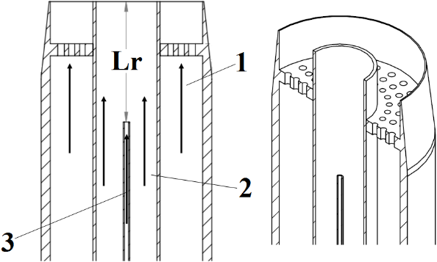
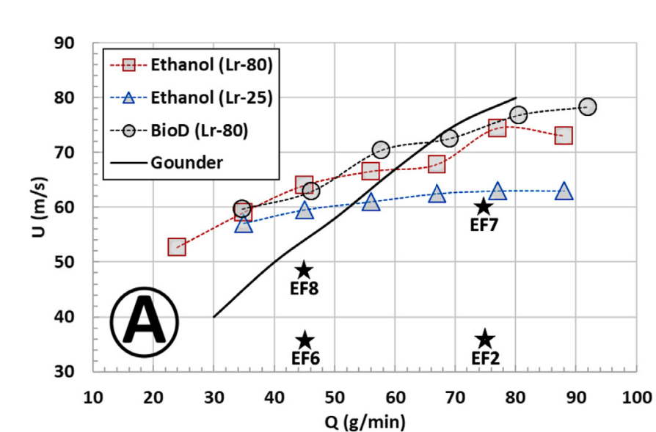
Needle Spray Cases for TCS-8
The spray is denser with reducing recess distance.
A liquid core is see at Lr=0mm.
Stability limits showing ethanol for Lr=25mm & 80mm. Solid line refers to fully dilute cases

Slide 2
Selected Cases for TCS-8
Two ethanol, dense spray flames are select for TCS8 Calculations:
Reacting Dense Spray Cases EF6 & EF8 for recess distance of Lr=25mm
Same liquid loading but different air-blast velocities.
Data available: velocity and droplet fields, LIF images, Temperature profiles.
Note: Current data is restricted to Ethanol sprays.
Two other data sets are made available for validation of calculations:
Near-dilute reacting spray cases EF6 & EF8 for recess distance of Lr=80mm
Non-Reacting spray cases for ES8 but at Lr = 0mm, 25mm, 80mm.

Slide 3
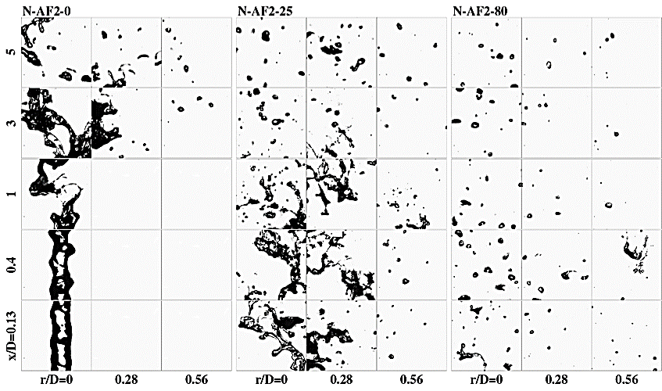
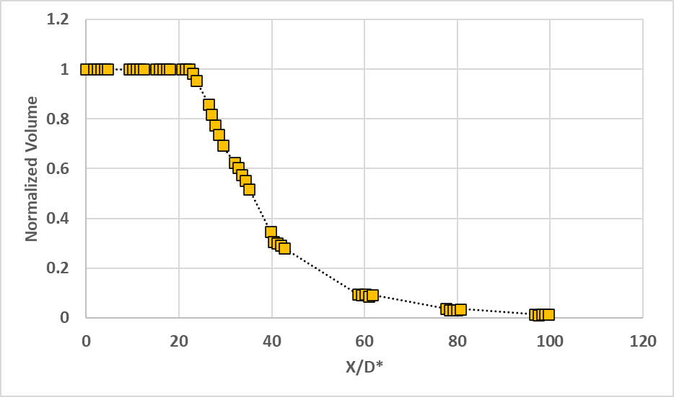
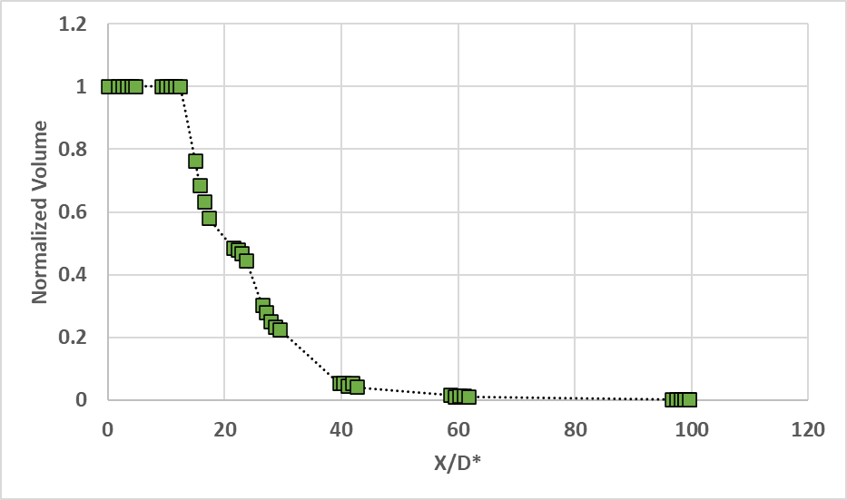
The Sydney Needle Spray Atomizer
Spray Structure at various distances from the jet exit plane with Lr=25mm
ES6
ES8
Measured liquid volume fraction at various distance from needle exit plane for selected cases: ES6 and ES8

Slide 4
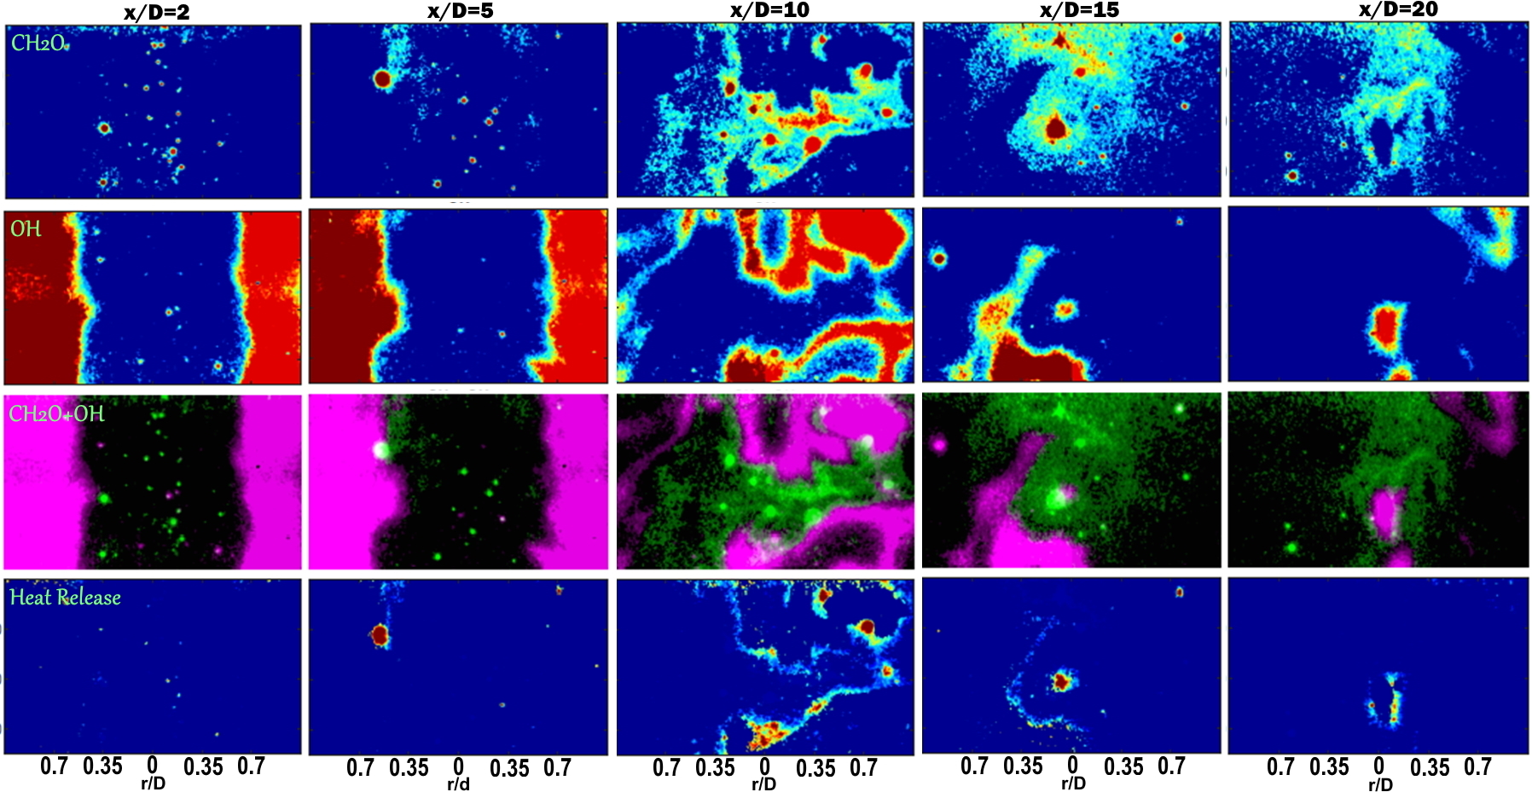
The Sydney Needle Spray Flames
CH₂O
Flame Structure at Recess Length = 25mm (Lr25)
OH
CH₂O+OH
Heat Release

Slide 5
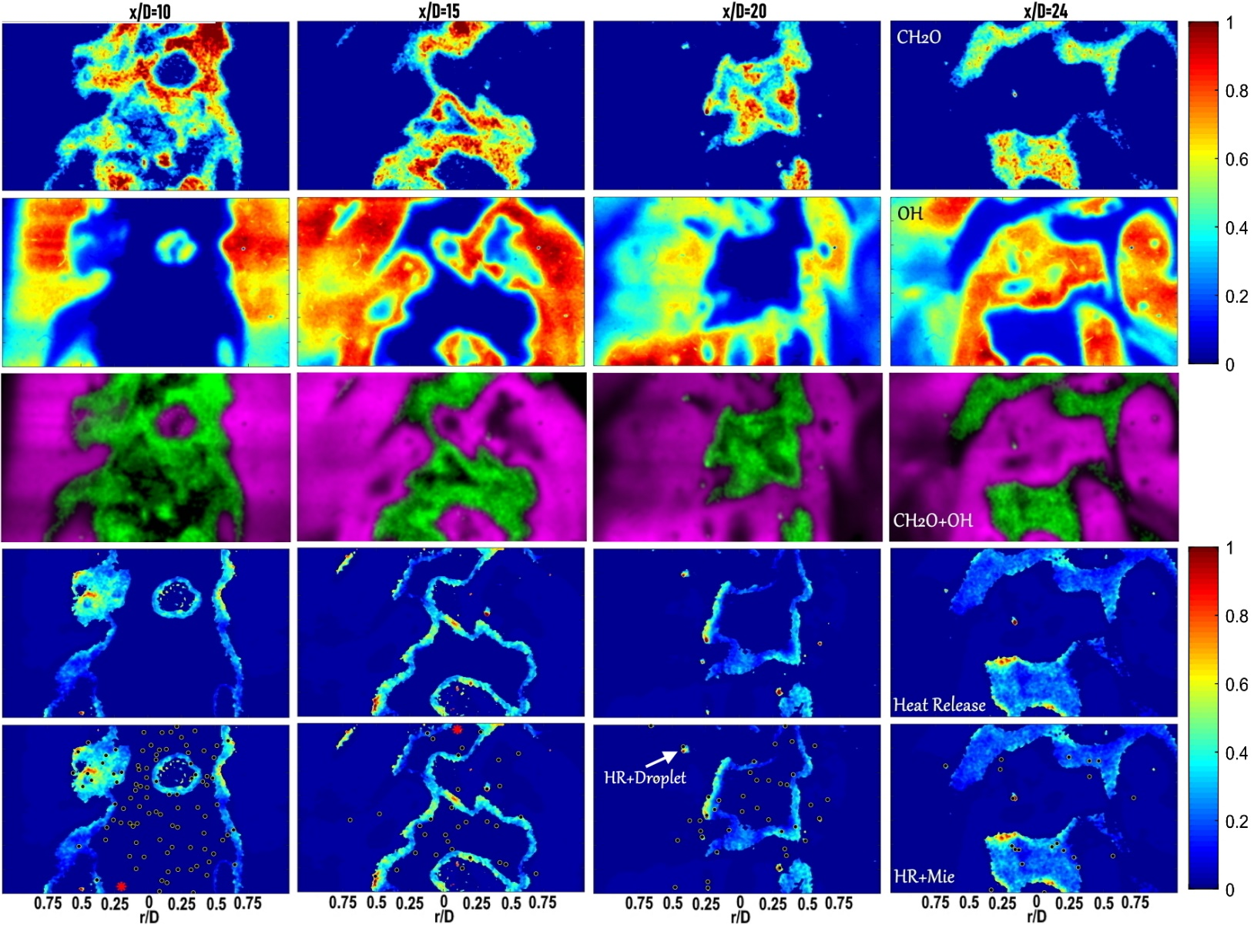
The Sydney Needle Spray Flames
CH₂O
Flame Structure at Recess Length = 80mm (Lr80)
OH
CH₂O+OH
Heat Release
HR + Mie

